Slide 1
2 – IB2d and IBAMR associated Files (.vertex, .spring, etc)

Slide 2
What do the different files do?
The main file is used to actually run the immersed boundary simulation.
It uses functions in IBM Blackbox / IBAMR.
You need to make sure that the path points to where these ibm functions live.
Other required files are input2d/input3d and .vertex.
There are optional files that add more features, such as .spring, .beam, .mass, etc.

Slide 3
Generate_mesh
The MATLAB generate_mesh files are not required.
This file is used to generate the .vertex, .spring, .beam files.
You could generate these files in other ways, such as writing a Python script, using Excel, etc.
If you change the generate_mesh file, you must run it to produce new .vertex, .spring, etc. files before you run the main2d/main3d again.

Slide 4
Input files
What do the different input files do?
The input2d and input3d (IBAMR only) files include a lot of information on physical parameters (density, viscosity, boundary conditions, domain size) and numerical parameters (dt, dx, printing intervals, etc.)
In addition to the input2d/input3d files, there are a number of files that specify the initial conditions and material properties of the immersed elastic structures.
The only such file that is required is the ".vertex" file, which specifies the initial positions of the IB points.
There are several additional files that may be optionally specified:
A ".spring" file can be used to specify an essentially arbitrary network of springs that connect the various IB points. Each "spring" connects precisely two IB points.
A ".beam" file can be used to specify a collection of linear beams with a preferred curvature. Each "beam" connects precisely three IB points.
Notes:
*

Slide 5
Input files cont’d
A ".target" file is used to specify IB points that are, by default, "tethered" by stiff linear springs to their initial positions. Note that it is also possible to update the location to which each target point is tethered to within a simulation, so as to provide an approximately-prescribed motion for the target points.
A ".mass" file is used to specify any additional mass associated with the IB points. In IBAMR for such files to have any effect, it is necessary that the IB solver be run in "penalty-IB" mode.
A ".anchor" file (IBAMR only) is used to specify "anchor" points. In IBAMR, anchor points are IB points that neither apply force to the fluid nor interpolate velocity from the fluid. They are literally anchored in place. (Note: Anchor points are distinct from target points. Target points can be thought of as being tethered to anchor points.)

Slide 6
Vertex file format
Vertex input files end with the extension ".vertex" and have the following format for two-dimensional models:
N # number of vertices in the file
x_0 y_0 # (x,y)-coordinates of vertex 0
x_1 y_1 # (x,y)-coordinates of vertex 1
...
x_{N-1} y_{N-1} # (x,y)-coordinates of vertex N-1
Vertex input files end with the extension ".vertex" and have the following format for three-dimensional models (IBAMR only):
N # number of vertices in the file
x_0 y_0 z_0 # (x,y,z)-coordinates of vertex 0
x_1 y_1 z_1 # (x,y,z)-coordinates of vertex 1
...
x_{N-1} y_{N-1} z_{N-1} # (x,y,z)-coordinates of vertex N-1

Slide 7
IBAMR / ib2d differences
In IBAMR, you can have multiple .vertex, .beam, etc. files for different boundaries.
In ib2d, multiple boundaries are combined into one long list.
This means that you have to keep track of where one boundary ends and the next starts.
For example, assume you have two plates. Plate1 is defined by vertices 1-100 and Plate2 by vertices 101-200.

Slide 8

Target point file format – ib2d
Target point input files end with the extension ".target" and have the following format:
The user provides a list of all target point indices with their associated target point stiffness.

Slide 9
Target point file format - IBAMR
Target point input files end with the extension ".target" and have the following format:
M # number of target points in the file
i_0 kappa_0 eta_0
# vertex index, penalty spring constant, penalty damping coefficient
i_1 kappa_1 eta_1
i_2 kappa_2 eta_2
...
Note:
Target points are anchored to their initial positions by linear springs with the specified spring constants and with zero resting lengths. Consequently, target points approximately enforce internal Dirichlet boundary conditions. The penalty parameter provides control over the energetic penalty imposed when the position of the Lagrangian immersed boundary point deviates from that of its specified fixed location.
Damping coefficients are optional and are set to 0.0 if not supplied. Target points are "anchored" in place using Kelvin-Voigt viscoelastic elements.

Slide 10
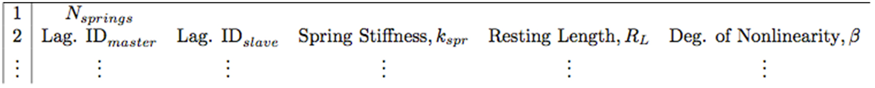
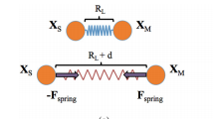
Spring file format (ib2d)
Spring input files end with the extension ".spring" and have the following format:
Note:
A list of the master and slave nodes for each linear spring along with their associated spring stiffness, resting-length, and degree of non-linearity. Note that if using only Hookean springs, the degree of non-linearity can be omitted and IB2d will automatically assume linear springs.
There is no restriction on the number of springs that may be associated with any particular node of the Lagrangian mesh.

Slide 11
Spring file format (IBAMR)
Spring input files end with the extension ".spring" and have the following format:
M # number of links in the file
i_0 j_0 kappa_0 length_0 fcn_idx_0
# first vertex index, second vertex index, spring constant,
# rest length, spring function index
i_1 j_1 kappa_1 length_1 fcn_idx_1
i_2 j_2 kappa_2 length_2 fcn_idx_2
...
Note:
There is no restriction on the number of springs that may be associated with any particular node of the Lagrangian mesh.
The rest length and force function index are optional values. If they are not provided, by default the rest length will be set to the value 0.0 and the force function index will be set to 0. This corresponds to a linear spring with zero rest length.

Slide 12
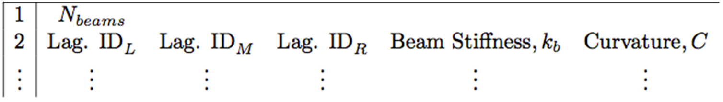
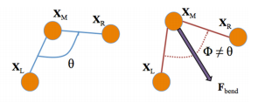
.beam file (torsional spring) – ib2d
Beam input files end with the extension ".beam" and have the following format:
This gives a list of the left, middle, and right Lagrangian indices associated with each torsional spring (beam) and their associated beam stiffness and curvature.

Slide 13
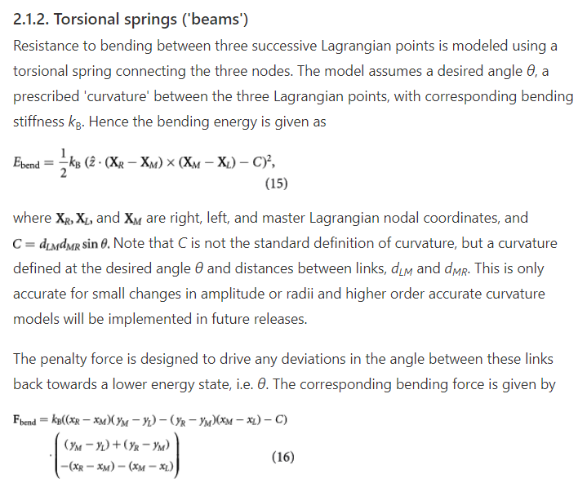
.beam file (torsional spring) – ib2d

Slide 14
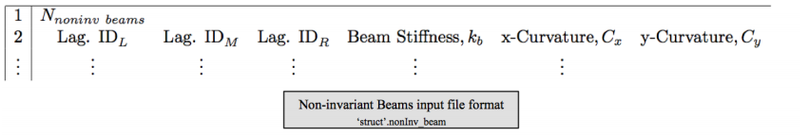
.nonInv_beam file (beam equation) – ib2d
Another way to model the resistance bending between three successive Lagrangian points (rather than using torsional springs) is by using a non-invariant beam connecting the three successive nodes. The model assumes a prescribed ‘curvature’ in both x and y components between the three Lagrangian points with corresponding bending stiffness k_{NIB}. The corresponding bending deformation forces are modeled as
F_{beam} = k_{NIB} ∂⁴/∂s⁴ (X(s, t) − X_{b}(s))
where X(s, t) is the current Lagrangian configuration at time t, e.g. the mapping of the Lagrangian points s to the underlying Cartesian grid, and X_{b}(s) is the preferred configuration of the fiber model.
This model is denoted as non-invariant beams since these beams are non-invariant under rotations, as opposed to the torsional spring fiber model. Similarly to the torsional spring model, non-invariant beam deformation forces can only occur on immersed boundary points on the interior or the fiber structure, not the endpoints.

Slide 15
Beam file format (IBAMR)
Beam input files end with the extension ".beam" and have the following format:
M # number of beams in the file
i_0 j_0 k_0 kappa_0
# first vertex index, second vertex index, third vertex index,
# bending rigidity
i_1 j_1 k_1 kappa_1
# first vertex index, second vertex index, third vertex index,
# bending rigidity
i_2 j_2 k_2 kappa_2
# first vertex index, second vertex index, third vertex index,
#bending rigidity ...
Note that IBAMR beams are noninvariant beams.

Slide 16
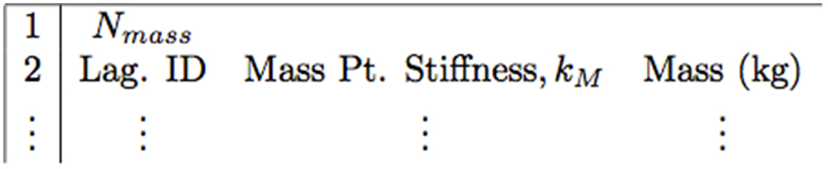
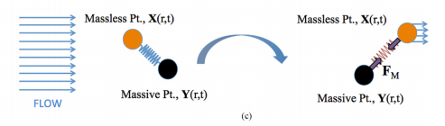
Mass point file format (ib2d)
.mass: A list of all Lagrangian mass point indices along with their associated mass-spring stiffness and mass.

Slide 17
Mass point file format (IBAMR)
Mass point input files end with the extension ".mass" and have the following format:
M # number of mass points in the file
i_0 mass_0 kappa_0 # vertex index, point mass, penalty spring constant
i_1 mass_1 kappa_1
i_2 mass_2 kappa_2
...
Note:
Mass points are anchored to "ghost" massive particles by linear springs with the specified spring constants and with zero resting lengths. The massive particles are "isolated" and simply move according to Newton's laws. The penalty parameter provides control over the energetic penalty imposed when the position of the Lagrangian immersed boundary point deviates from that of its massive copy.

Slide 18
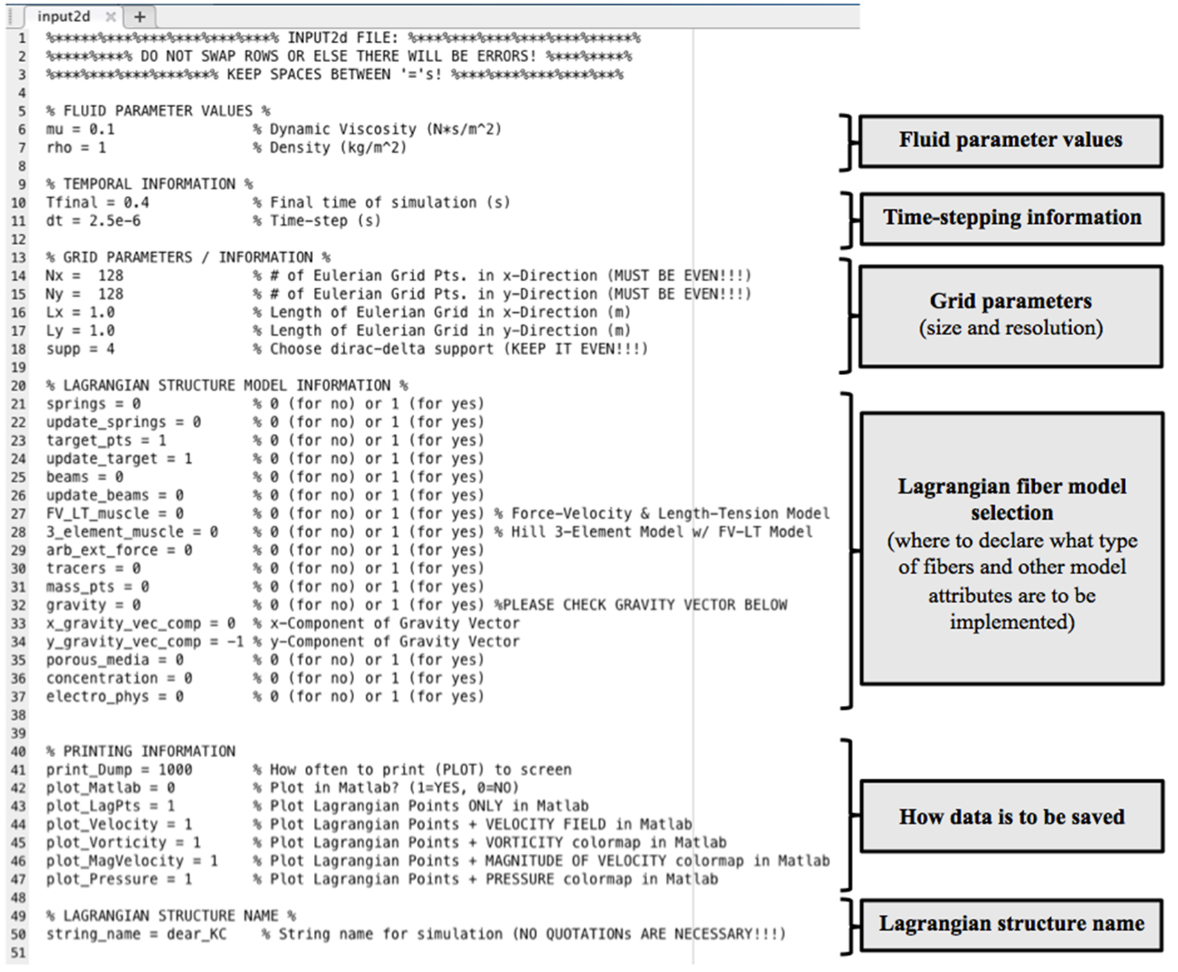
Input2d – ib2d

Slide 19
Input2d IBAMR
There are more options in the IBAMR input2d/input3d files, and we will discuss these more in the future.
The main features that are relevant to our initial examples will be outlined here.

Slide 20
Creating geometries
When you create a new simulation, you want to consider what is the size of your fluid domain, L, and what is the spatial step, dx = L/N.
The immersed boundary will have vertices spaced ds = dx/2 apart (ib2d, fiber based IBAMR) or ds = dx (IBFE).
You want to make sure your immersed boundary fits in the domain.

Slide 21
Ib2d and IBAMR fluid domains
In Ib2d, the bottom left corner is always at the origin.
If the dimensions are LxW, then the corners of the domain are (0,0), (L,0), (L,W), and (0,W). The immersed boundary must fit inside this.
The domain for IBAMR can be placed anywhere. In many of the examples, the origin is at the center of the domain.

Slide 22
Rubber band example
Analogous examples for ib2d and IBAMR are available on github:
2-IBAMR-Example_2Drubber_band
2-IB2d-Example_2Drubber_band
The MATLAB code creates the .vertex and .spring files for a rubber band that resists stretching. This can be used to create .vertex and .spring files for both ib2d and IBAMR.

Slide 23
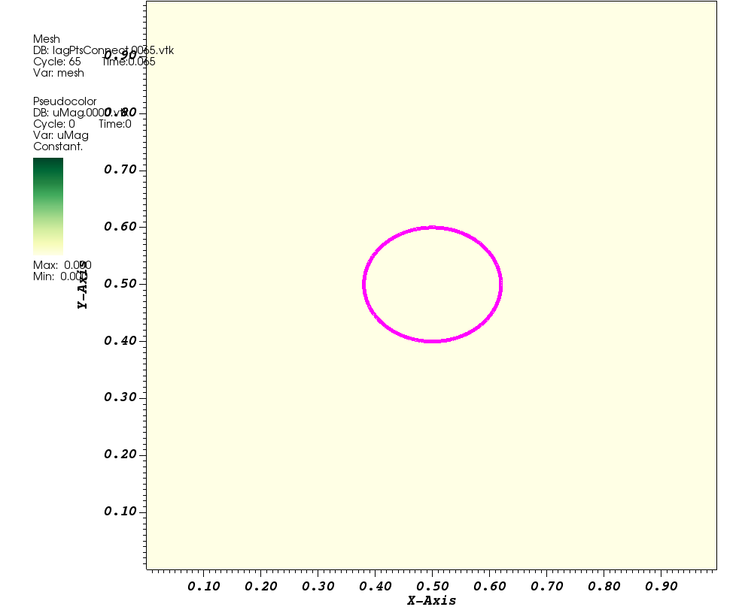
The rubber band is slightly deformed and will wobble as it returns to the shape of a perfect circle.
This is an ib2d simulation where the bottom left corner is the origin, and the domain is 1x1.

Slide 24
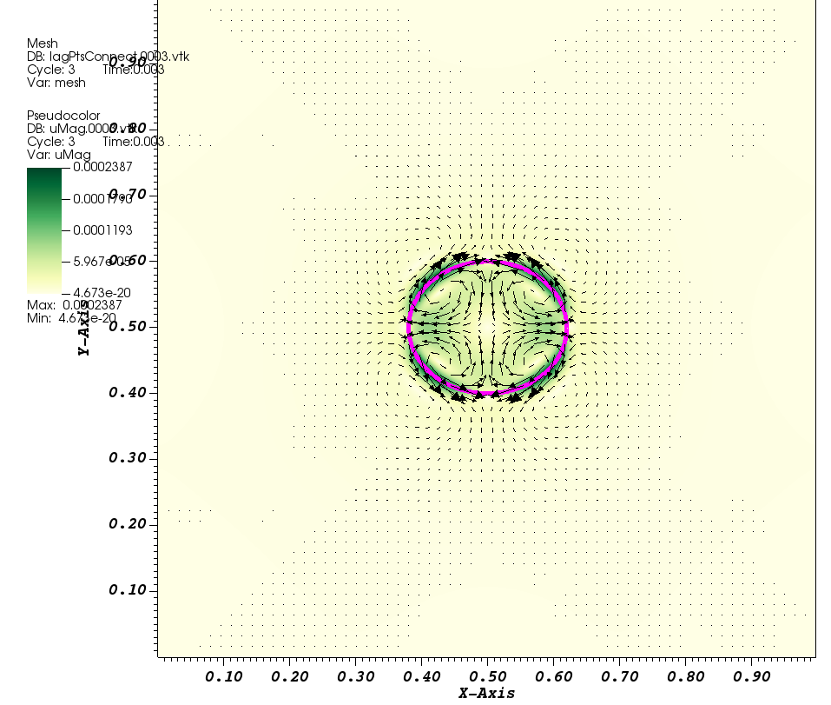

Slide 25
generate_mesh2d.m - IBAMR
L = 1; % length of computational domain (m)
N = 512; % number of Cartesian grid meshwidths at the finest level of the AMR grid
dx = L/N; % Cartesian mesh width (m)
radius = 0.1; % radius of band (m)
epsilon = 0.005; % deformation in the x-direction
band_length = 2*pi*radius; % rubber band length (m)
npts = ceil(2*(band_length/L)*N); % number of points along the rubber band
ds = band_length/(npts); % physical distance between neighboring Lagrangian mesh points (m)
dtheta = 2*pi/npts;
mesh_name = 'rubber_band_'; % structure name
kappa_spring = 2.0e3; % spring constant (Newton)
kappa_beam = 5.0e-3; % beam stiffness constant (Newton m^2)

Slide 26
Generate_mesh2d.m .vertex
%%%%%%%%%%%%%%%%%%%%%%%%%%%%%%%%%%%%%%%%%%%%%%%%%%%%%%%%%%%%%%%%%%%%%%%%%%%%%%%%
% Write out the vertex information
vertex_fid = fopen([mesh_name num2str(N) '.vertex'], 'w');
fprintf(vertex_fid, '%d\n', npts);
for s = 0:npts-1
X(1) = (radius+epsilon)*sin(s*dtheta);
X(2) = radius*cos(s*dtheta);
fprintf(vertex_fid, '%1.16e %1.16e\n', X(1), X(2));
end
fclose(vertex_fid);
%%%%%%%%%%%%%%%%%%%%%%%%%%%%%%%%%%%%%%%%%%%%%%%%%%%%%%%%%%%%%%%%%%%%%%%%%%%%%%%%

Slide 27
rubber_band_512.vertex
644
0.0000000000000000e+00 1.0000000000000001e-01
1.0244161346221071e-03 9.9995240574191152e-02
2.0487347565924115e-03 9.9980962749807278e-02
3.0728583625411962e-03 9.9957167885933298e-02
4.0966894676620277e-03 9.9923858247566999e-02
5.1201306149911948e-03 9.9881037005403420e-02
6.1430843846844874e-03 9.9828708235533081e-02
7.1654534032904536e-03 9.9766876919053921e-02
8.1871403530192222e-03 9.9695548941597226e-02
9.2080479810060564e-03 9.9614731092767334e-02
1.0228079108568690e-02 9.9524431065495328e-02
1.1247136640457638e-02 9.9424657455306847e-02
1.2265123574098539e-02 9.9315419759503781e-02
1.3281943008825695e-02 9.9196728376260312e-02
1.4297498155105894e-02 9.9068594603633084e-02
1.5311692343751664e-02 9.8931030638485795e-02
1.6324429035123069e-02 9.8784049575328159e-02
1.7335611828317186e-02 9.8627665405069495e-02
1.8345144470344348e-02 9.8461893013686907e-02

Slide 28
Generate_mesh2d.m .spring (ib2d)
%%%%%%%%%%%%%%%%%%%%%%%%%%%%%%%%%%%%%%%%%%%%%%%%%%%%%%%%%%%%%%%%%%%%%%%%%%%%%%%%
% Write out the spring information
spring_fid = fopen([mesh_name num2str(N) '.spring'], 'w');
fprintf(spring_fid, '%d\n', npts);
for s = 1:npts-1
fprintf(spring_fid, '%d %d %1.16e %1.16e\n', s, s+1, kappa_spring*ds/(ds^2), ds);
End
if s == npts
fprintf(spring_fid, '%d %d %1.16e %1.16e\n', npts, 1, kappa_spring*ds/(ds^2), ds);
end
fclose(spring_fid);
%%%%%%%%%%%%%%%%%%%%%%%%%%%%%%%%%%%%%%%%%%%%%%%%%%%%%%%%%%%%%%%%%%%%%%%%%%%%%%%%

Slide 29
Generate_mesh2d.m .spring (IBAMR)
%%%%%%%%%%%%%%%%%%%%%%%%%%%%%%%%%%%%%%%%%%%%%%%%%%%%%%%%%%%%%%%%%%%%%%%%%%%%%%%%
% Write out the spring information
spring_fid = fopen([mesh_name num2str(N) '.spring'], 'w');
fprintf(spring_fid, '%d\n', npts);
for s = 0:npts-2
fprintf(spring_fid, '%d %d %1.16e %1.16e\n', s, s+1, kappa_spring*ds/(ds^2), ds);
End
if s == npts-1
fprintf(spring_fid, '%d %d %1.16e %1.16e\n', npts-1, 0, kappa_spring*ds/(ds^2), ds);
end
fclose(spring_fid);
%%%%%%%%%%%%%%%%%%%%%%%%%%%%%%%%%%%%%%%%%%%%%%%%%%%%%%%%%%%%%%%%%%%%%%%%%%%%%%%%

Slide 30
rubber_band_512.spring –ib2d
644
1 2 2.0499156670236122e+06 9.7564989241919039e-04
2 3 2.0499156670236122e+06 9.7564989241919039e-04
3 4 2.0499156670236122e+06 9.7564989241919039e-04
4 5 2.0499156670236122e+06 9.7564989241919039e-04
5 6 2.0499156670236122e+06 9.7564989241919039e-04
6 7 2.0499156670236122e+06 9.7564989241919039e-04
7 8 2.0499156670236122e+06 9.7564989241919039e-04
8 9 2.0499156670236122e+06 9.7564989241919039e-04
9 10 2.0499156670236122e+06 9.7564989241919039e-04
10 11 2.0499156670236122e+06 9.7564989241919039e-04
11 12 2.0499156670236122e+06 9.7564989241919039e-04
12 13 2.0499156670236122e+06 9.7564989241919039e-04
13 14 2.0499156670236122e+06 9.7564989241919039e-04
14 15 2.0499156670236122e+06 9.7564989241919039e-04
15 16 2.0499156670236122e+06 9.7564989241919039e-04
16 17 2.0499156670236122e+06 9.7564989241919039e-04
17 18 2.0499156670236122e+06 9.7564989241919039e-04
18 19 2.0499156670236122e+06 9.7564989241919039e-04
19 20 2.0499156670236122e+06 9.7564989241919039e-04
20 21 2.0499156670236122e+06 9.7564989241919039e-04

Slide 31
rubber_band_512.spring -IBAMR
644
0 1 2.0499156670236122e+06 9.7564989241919039e-04
1 2 2.0499156670236122e+06 9.7564989241919039e-04
2 3 2.0499156670236122e+06 9.7564989241919039e-04
3 4 2.0499156670236122e+06 9.7564989241919039e-04
4 5 2.0499156670236122e+06 9.7564989241919039e-04
5 6 2.0499156670236122e+06 9.7564989241919039e-04
6 7 2.0499156670236122e+06 9.7564989241919039e-04
7 8 2.0499156670236122e+06 9.7564989241919039e-04
8 9 2.0499156670236122e+06 9.7564989241919039e-04
9 10 2.0499156670236122e+06 9.7564989241919039e-04
10 11 2.0499156670236122e+06 9.7564989241919039e-04
11 12 2.0499156670236122e+06 9.7564989241919039e-04
12 13 2.0499156670236122e+06 9.7564989241919039e-04
13 14 2.0499156670236122e+06 9.7564989241919039e-04
14 15 2.0499156670236122e+06 9.7564989241919039e-04
15 16 2.0499156670236122e+06 9.7564989241919039e-04
16 17 2.0499156670236122e+06 9.7564989241919039e-04
17 18 2.0499156670236122e+06 9.7564989241919039e-04
18 19 2.0499156670236122e+06 9.7564989241919039e-04
19 20 2.0499156670236122e+06 9.7564989241919039e-04

Slide 32
MATLAB files to check geometry
On github, go to IBAMR-Tutorials/MATLAB codes/
read_Vertex_Points_and_Plot_Them.m – reads your .vertex file and plots it
test_IB_Geometry_and_Springs – reads .vertex and .spring files and plots them with index labels

Slide 33
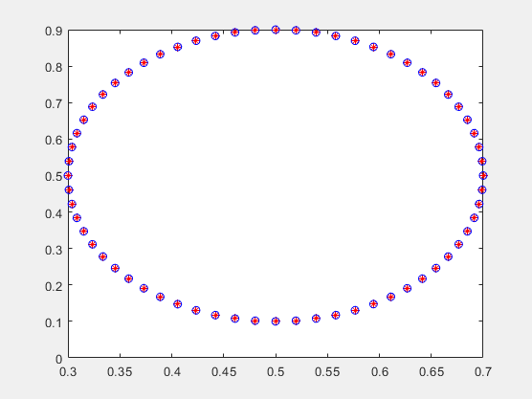
read_Vertex_Points_and_Plot_Them

Slide 34
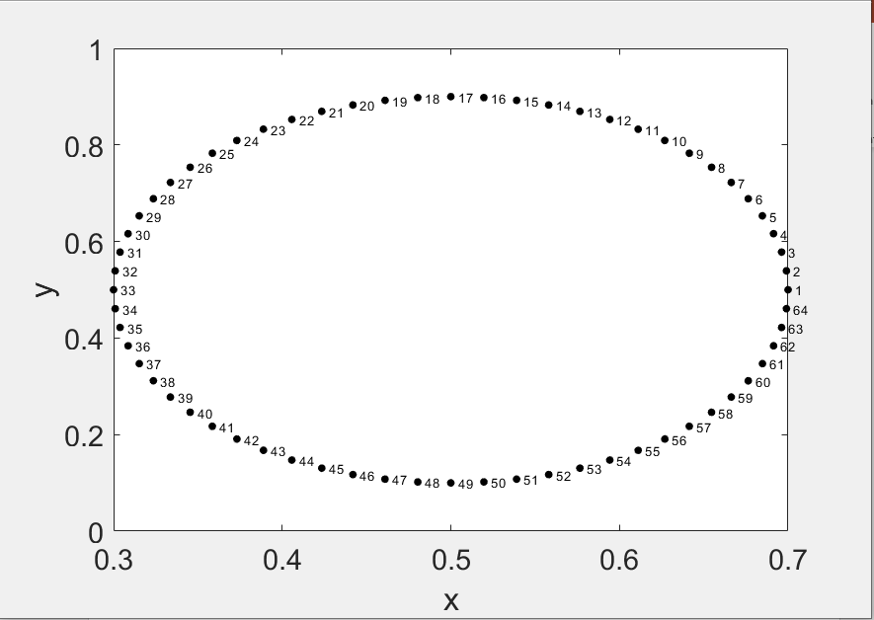
test_IB_Geometry_and_Springs

Slide 35
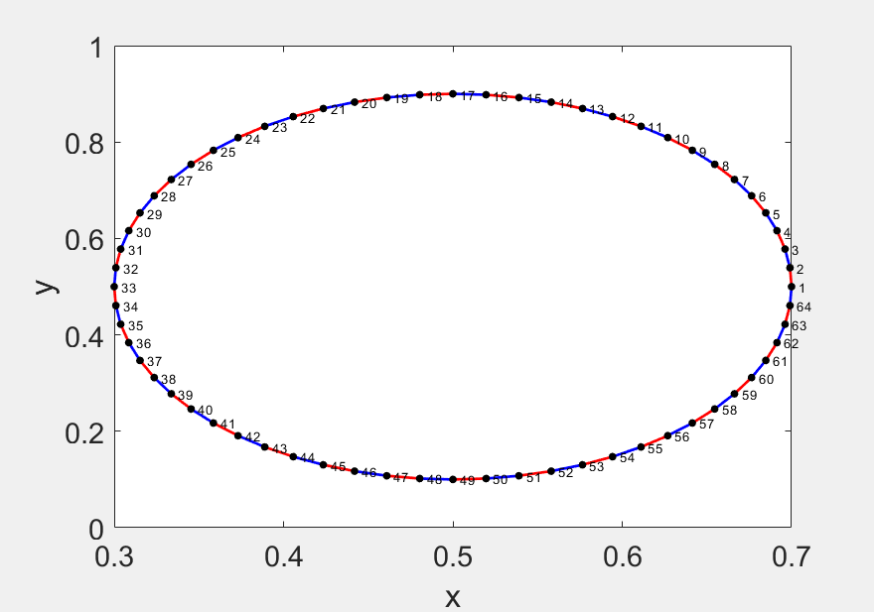
test_IB_Geometry_and_Springs

Slide 36
Ib2d / IBAMR option
Note that in test_IB_Geometry_and_Springs, to correctly plot the spring indices, you need to flag if its ib2d (MATLAB indices that start at 1) or IBAMR (C indices that start at 0).
%------------------------------------
% FLAG FOR IB2d or IBAMR
%------------------------------------
flag_IBAMR = 0; % 0 for IB2d, 1 for IBAMR

Slide 37
HW – Create your own geometry
You can either modify the rubber band example or create your own function from scratch.
You could write generate_mesh in Python, Julia, MATLAB, etc.
Be sure to make a sketch of the fluid domain, calculate dx, ds, etc. before writing your code.

Slide 38
Project Goals
Ib2d/IBAMR – 2D moving boundary problem using finite differences.
Challenge – write code that writes out x,y coordinates.
Examples
2D barb accelerating towards a circle
2D heart tube that pumps
2D flexible leaf that vibrates in flow
ANSYS – 3D problem, no moving boundary.
Challenge – make a 3D object and discretize using finite element mesh.
Examples
3D barb of complex geometry that does not move, but rather flow is driven past it.
3D complex developing heart geometry (trabeculae, ballooning chambers) and flow is driven through it.
3D leaf with complex shape that does not move with flow moving past it.

